Slide 2
Vision 1
English for Schools
Lesson 1
Saving Nature
Compiled by : Ali Khezri

Slide 4
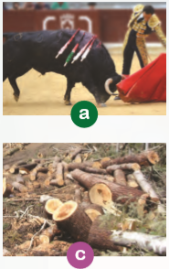
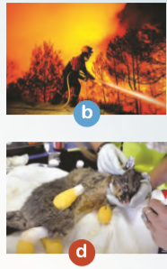
A. Match the pictures with the phrases.
hurting the animal
صدمه زدن به حیوان
putting out the fire
خاموش کردن آتش
helping the injured animal
کمک کردن به حیوان صدمه دیده
cutting down the trees
بریدن درختان

Slide 5
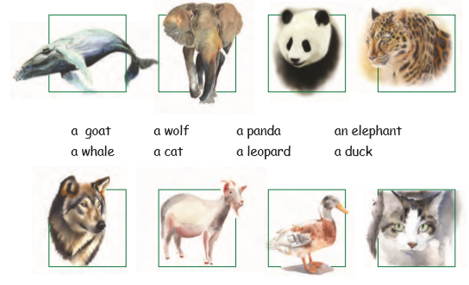
A. Match the pictures with the words.

Slide 6
B. Can you divide the above animals into two groups? How?
wild
Domestic
a duck
a wolf
a goat
a panda
a cat
an elephant
a leopard
a whale

Slide 7
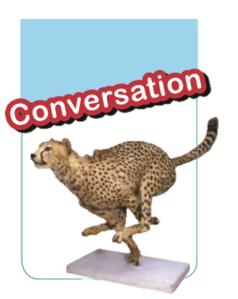
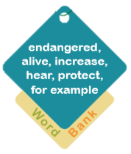
درمعرض خطر
زنده
افزایش
شنیدن
حفاظت
برای مثال

Slide 8
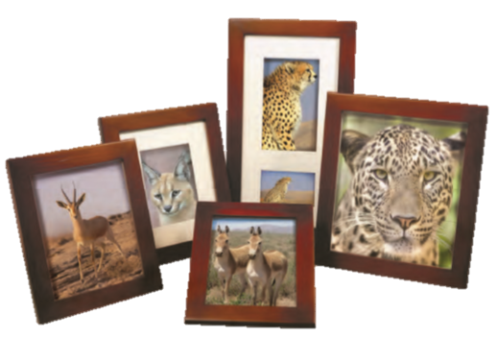
E. Read the following paragraph and choose the best verb forms.
Alfredo is an Italian tourist. He lives / will live in Rome. He likes/ will like to travel and see different places of the world. He takes/will take photos especially of animals. Next month, he and his wife travel/will travel to Iran. They go/will go to Tooran Plain to see animals. They are hopeful to see Persian zebra, Iranian cheetah, Persian leopard and gazelle. After two weeks, they visit/will visit some beautiful cities in Iran.

