Slide 1
By
F. Ghavipanjeh
fghavipanjeh@gmail.com

Slide 2
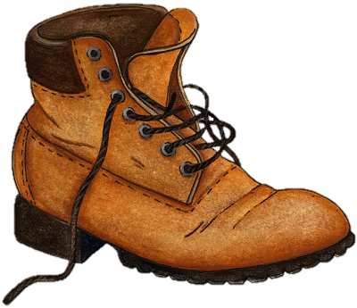
boot

Slide 3
tie

Slide 4
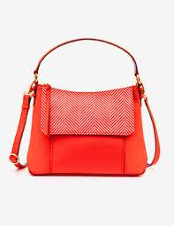
bag

Slide 5
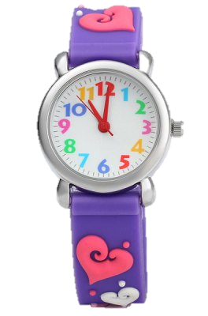
watch

